Slide 1
Books, Training Manuals or Publications by or about Haz-Mat 1 Members
This is a collection of printed material that can be associated with the members of Haz-Mat 1. The members mentioned were instrumental in the writing of books, the development of training materials as subject matter experts, as Lead or Master Instructors for many educational institutions, or have been written about by other authors. It is not a complete list and will be updated from time to time.

Slide 2
With his fifth edition, Chief John Norman offers lessons learned during his extensive and time-honored career. Chief Norman imparts wisdom and experience by offering advice informed by actual outcomes from the fireground. This guide continues to be invaluable for firefighters aspiring to the officer level and those seeking to promote safety and effectiveness in their organization and the communities they serve by improving their own skills. This fifth edition conveys valuable information gained over the past several years from scientific research relating to the tactics that we use to the changes that have taken place within our communities. Failure to recognize change and adapt to it places a fire department at a great disadvantage and can cost lives and property. The community changes that most directly affect the fire service today include faster, hotter, and more toxic fires and significantly reduced staffing in many fire departments. These are inescapable facts. Our challenge is to use the knowledge that is at our disposal to select the right tools, technologies, and tactics to safely and successfully adapt to and overcome these challenges.

Slide 3
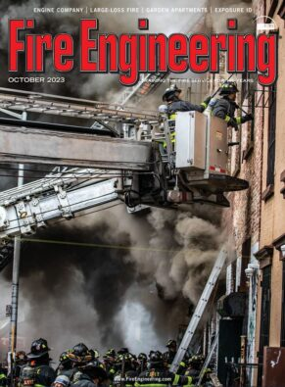
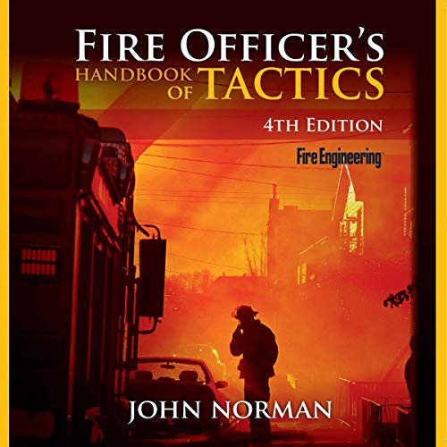
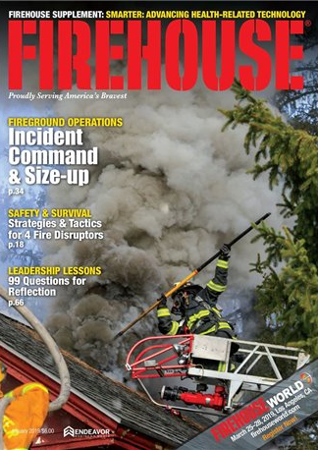
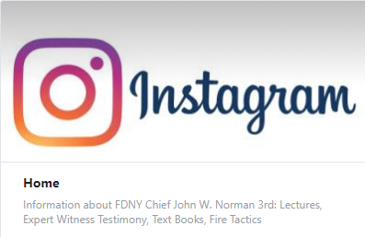
John was a frequent contributor
Other writings or articles by
JOHN NORMAN
John wrote Bi-monthly for over 20 years

Slide 4
Book Overview
With his fifth edition, Chief John Norman offers lessons learned during his extensive and time-honored career. Chief Norman imparts wisdom and experience by offering advice informed by actual outcomes from the fireground. This guide continues to be invaluable for firefighters aspiring to the officer level and those seeking to promote safety and effectiveness in their organization and the communities they serve by improving their own skills. This fifth edition conveys valuable information gained over the past several years from scientific research relating to the tactics that we use to the changes that have taken place within our communities. Failure to recognize change and adapt to it places a fire department at a great disadvantage and can cost lives and property. The community changes that most directly affect the fire service today include faster, hotter, and more toxic fires and significantly reduced staffing in many fire departments. These are inescapable facts. Our challenge is to use the knowledge that is at our disposal to select the right tools, technologies, and tactics to safely and successfully adapt to and overcome these challenges. This description may be from another edition of this product.

Slide 5
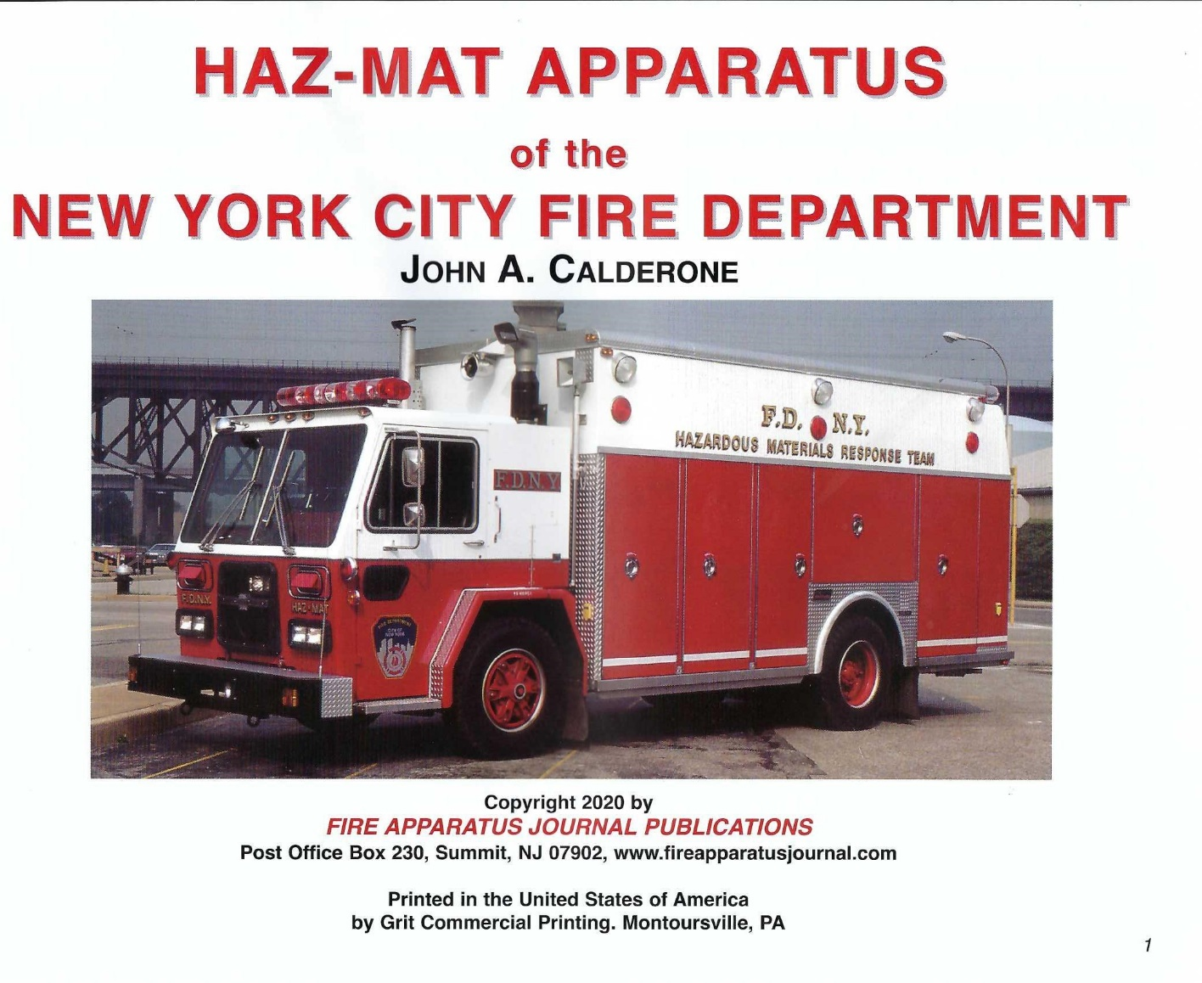

Slide 6
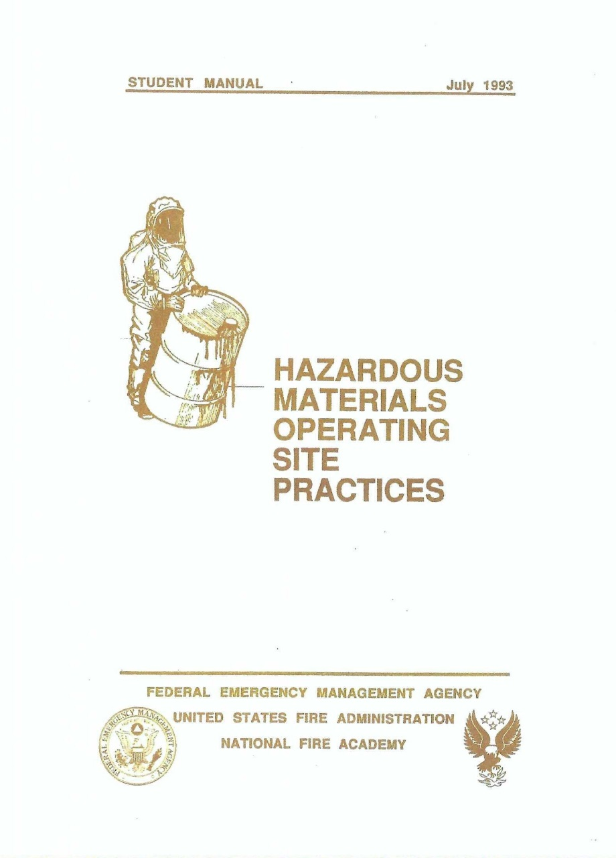
National Fire Academy
Course Developers & Subject Matter Experts
Darrell Begnaud
LSU Fireman Training LA.
Dan Civello
Jefferson Parish LA.
Dave Lesak
Leigh County Haz-Mat PA.
Philip H. McArdle
FDNY Haz-Mat 1 NY.
Mike Shannon
Oklahoma City Haz-Mat OK.
Patrick Walsh
Washington DC Haz-Mat DC.

Slide 7
National Fire Academy
Lead Instructors
Noel Waters
Rick Gimbl
Phil McArdle
Vinny Doherty
Kevin Culley
Kevin Smith
Hazardous
Materials
Tactical
Considerations

Slide 8
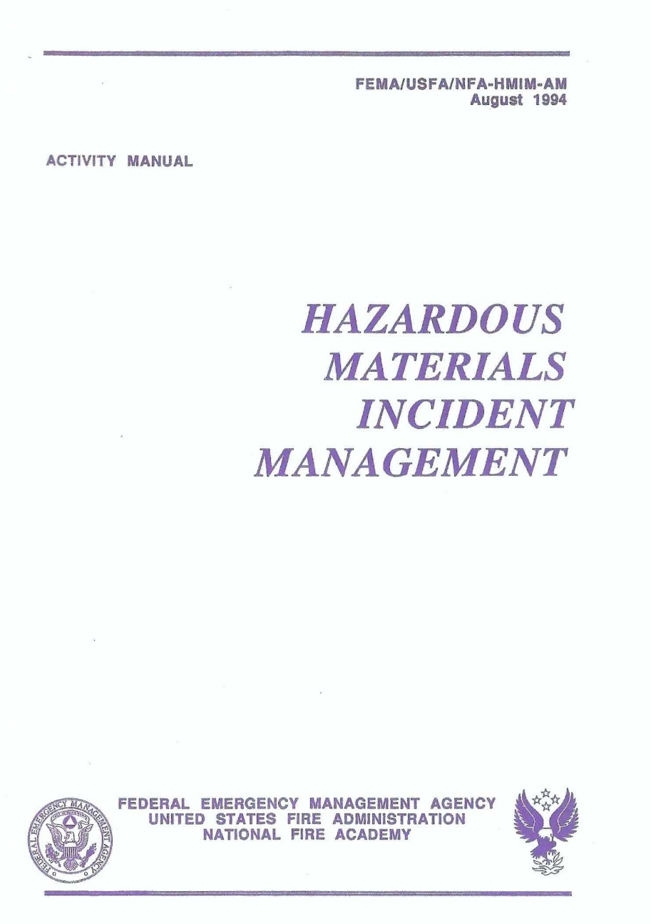
National Fire Academy
Course Developers & Subject Matter Experts / Adjunct Faculty Lead Instructors
Noel Waters (Program Chair)
FDNY Haz-Mat-1 NY
Dave Lesak
Leigh County Haz-Mat PA.
Philip H. McArdle
FDNY Haz-Mat 1 NY.
Mike Shannon
Oklahoma City Haz-Mat OK.
Patrick Walsh
Washington DC Haz-Mat DC.

Slide 9
National Fire Academy
Adjunct Faculty Lead Instructors
Kevin Culley
Vinny Doherty
Kevin Smith
Noel Waters

Slide 10
Report from Ground Zero by Dennis Smith
Jeff Borkowski & Phil McArdle are mentioned in the book about their Rescue of Daily News Photographer David Handshue during the collapse of the South Tower of the World Trade Center on pages 118-122

Slide 11
Ray Downey wrote the first edition of The Rescue Company in the early 1990s. Building on Downey's legacy, John Norman has written Fire Department Special Operations to take into consideration the earth-shattering events, funding increases, research advances, expanded capabilities, and changes in regulations and standards that have widened the knowledge gap since the publication of Chief Downey's book. Fire Department Special Operations is an excellent guide for agencies and individuals in establishing, staffing, operating, and maintaining heavy rescue units in the many forms they may take. It is also an ideal training resource for the officers and individuals assigned the duties that a rescue firefighter must accomplish.
Part One: Getting started * What rescue is all about * Ways of providing rescue service * Recruiting and staffing * Apparatus * Tools and equipment * Maintenance * Training * The operational plan * Air tools * Rigging * Victim care, packaging, and handling * Part Two: Rescue incidents * Responses: Using special units at fires and emergencies * Buried victims: trench and other excavation rescue work * Elevators, escalators, impalements, and "man-in-machine" runs * High-angle rescue, scaffolds, and other events * Confined space rescue * Structural collapse rescue * Vehicle extrication: planes, trains, and automobiles * Water and ice rescue * Hazardous materials operations * Electrical emergencies * Major event planning * Part Three: Appendixes * Appendix A: Sample application * Appendix B: Operational guidelines: Rescue Company 1 * Appendix C: Rescue 1 Tool list * Index * Supreme sacrifices

Slide 12
John Norman, author of the best-selling Fire Officer's Handbook of Tactics , brings his own remarkable story to life in this new highly anticipated memoir. But this is a story about all firefighters--the men and women who are absolutely the salt of the earth, whose sole mission is to protect the lives and property of their neighbors. This book celebrates the lives of firefighters--a truly special group of people--and reintroduces them to the American public. What is a hero? A hero is a role model. To be a hero means protecting others at great personal risk because it's the right thing to do. "Since September 11, 2001," Norman writes, "people have been speaking about firefighters as 'America's Heroes.' I truly believe they are heroes in the classical sense of the word." Renowned for combining compelling storytelling with industry-standard tactical training, Norman offers an unparalleled look into the modern history of America's fire service from a front-row seat. This is a celebration of the best in public service, its sacrifices and triumphs, and the people who were there, who will insist with uncommon humility, "I was just doing my job." This description may be from another edition of this product.

Slide 13
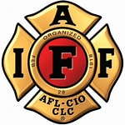
IAFF Master Trainers
Jeff Borkowski
Nicholas Del Ray
Jack Fanning
Tom Gardner
Phil McArdle
Tony Mussorfitti

Slide 14
IAFF Master Trainers
Jeff Borkowski
Nicholas Del Ray
Jack Fanning
Tom Gardner
Phil McArdle
Tony Mussorfitti

Slide 15
IAFF Master Trainers
Jeff Borkowski
Nicholas Del Ray
Jack Fanning
Tom Gardner
Phil McArdle
Tony Mussorfitti

Slide 16
IAFF Master Trainers
Jeff Borkowski
Nicholas Del Ray
Jack Fanning
Tom Gardner
Phil McArdle
Tony Mussorfitti

Slide 17
IAFF Master Trainers
Jeff Borkowski
Nicholas Del Ray
Jack Fanning
Tom Gardner
Phil McArdle
Tony Mussorfitti

Slide 18
John Berna, Jack Calderone Phil McArdle & John Norman appear in this book
They Saved New York' captures many deeply moving and private stories of tragedy and joy in the lives of firefighters. This book documents actual people and events of the FDNY. They are stories that every firefighter in the world understands, and everyone who admires firefighters will appreciate. They Saved New York is a book about people who head into burning buildings when everyone else is running out. Glenn Usdin is a professional photographer and a firefighter for over 40 years who has been photographing fires and firefighters in NYC since the mid 1970’s. Dan Potter is a retired FDNY firefighter with the ability to tell the stories that bring the reader right into the firehouse or on the fireground. Together, Usdin and Potter conceived, photographed and told the stories that captures a wide range of firefighters in They Saved New York. In the late 1960s, through the 1980s, the New York Fire Department experienced a historic rapid amount of fire duty. The firefighters who worked those years saw more actual fires in a week than most firefighters across the country saw in a year. Usdin felt strongly that these firefighter’s legacies needed to be preserved and honored in a unique way. That was the inspiration for the project. Dan Potter spent hundreds of hours interviewing featured firefighters and then crafted their stories for the book with his deft writing style. Usdin captured evocative portraits of each of them as well as hundreds of action photos he shot at fire scenes over 40+ years. The result is a large format photo documentary that honors the profession as well as the featured individuals. They Saved New York is filled with photographs and stories of tribute and remembrance from 90 members of the New York City Fire Department, ranging from brand new firefighters to some of the most seasoned veterans. “It is a story of resiliency and perseverance ……”--Frank Leeb, Deputy Assistant Chief, FDNY

Slide 20
Development Team members: Noel Waters (Program Chair) David Lesak, Phil McArdle, Pat Walsh

Slide 21
Development Team members: Noel Waters (Program Chair) David Lesak, Phil McArdle, Pat Walsh
Company
Officer

Slide 22
Development Team members: Noel Waters (Program Chair) David Lesak, Phil McArdle, Pat Walsh
The Federal Emergency Management Agency (FEMA) was established in 1979. FEMA's mission is to focus Federal effort on preparedness for, mitigation of, response to, and recovery from emergencies encompassing the full range of natural and manmade disasters. FEMA's National Emergency Training Center (NETC) in Emmitsburg, Maryland, includes the United States Fire Administration (USFA), its National Fire Academy (NFA), and the Emergency Management Institute (EMI). To achieve the USFA's legislated mandate (under Public Law 93-498, October 29, 1974), "to advance the professional development of fire service personnel and of other persons engaged in fire prevention and control activities," the U. S. Fire Administration has developed an effective program linkage with established fire training systems which exist at the State and local levels. It is the responsibility of the USFA to support and strengthen these delivery systems. The field courses of the USFA's National Fire Academy have been sponsored by the respective State fire training systems in every State. In recent years increasing responses to a wide variety of emergency situations have raised dramatically the fire service's awareness of the need for safety programs. These programs are crucial for all firefighters who respond to emergency situations. Today, this is potentially any firefighter, whether in a large department or in a small, rural fire company. This course addresses the special needs of first responders responding to incidents that have been caused by terrorist action. The response builds upon the firm foundation provided by the curriculum offered at the Academy and adds specialized information concerning such topics as: • Tactical Considerations for Company Officer Response; • Tactical Considerations for HazMat Response; • Tactical Considerations for EMS Response. USFA's National Fire Academy is proud to join with State and local fire agencies i
Tactical
Considerations

Slide 23
Development Team members: Noel Waters (Program Chair) David Lesak, Phil McArdle, Pat Walsh
Incident
Command

Slide 24
Development Team Members Patrick Walsh & Phil McArdle
This counterterrorism Job Aid is designed to assist emergency response personnel in identifying a possible terrorist/ Weapons of Mass Destruction (WMD) incident and implementing initial actions. It identifies both strategic and tactical considerations that should be assessed within the first hour of an incident, providing clear, step-by-step checklists in a handy laminated, spiral-bound, pocket guide format.
This Emergency Response to Terrorism Job Aid has been designed, produced and distributed through a joint partnership of: The Department of Homeland Security (DHS) and its Office for Domestic Preparedness (ODP); Federal Emergency Management Agency (FEMA); United States Fire Administration (USFA); and the United States Department of Justice (DOJ) Office of Justice Programs. Edition 2.0.

Slide 25
Course Development & SMEs John Flynn Phil McArdle
The IRTB course provides first responders with the knowledge and skills necessary to safely respond to terrorist incidents involving explosives. The IRTB course focuses on first responder health and safety by addressing personal protection issues that arise when responding to terror incidents involving commercial and homemade explosive. Additionally, the course includes information on the recognition of Improvised Explosive Devices (IEDs); terrorist organizations, both foreign and domestic; and lessons learned from past terrorist incidents. This information better prepares first responders to safely recognize and respond to terrorist bombing threats.

Slide 26
Instructors from Haz-Mat 1 included: Ed Tomazewski, John Larocchia, Phil McArdle & Jeff Borkowski
Awareness Level courses are designed for responders who require the skills necessary to recognize and report a potential catastrophic incident or who are likely to witness or investigate an event involving the use of hazardous and/or explosive devices.
Performance Level courses are designed for first responders who perform tasks during the initial response to a catastrophic event.
Management and Planning Level courses are designed for managers who build plans and coordinate the response to a high-consequence event (either man-made or natural).
Web courses are designed for busy professionals like you. Your coursework can be done according to your schedule, allowing you to advance your career while still enjoying your personal life!

