Slide 1
Captains in Haz-Mat History
This section is about the Officers who eventually commanded Haz-Mat-1
As Captains

Slide 2
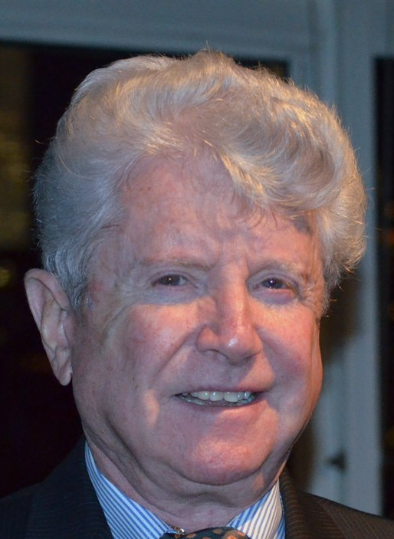
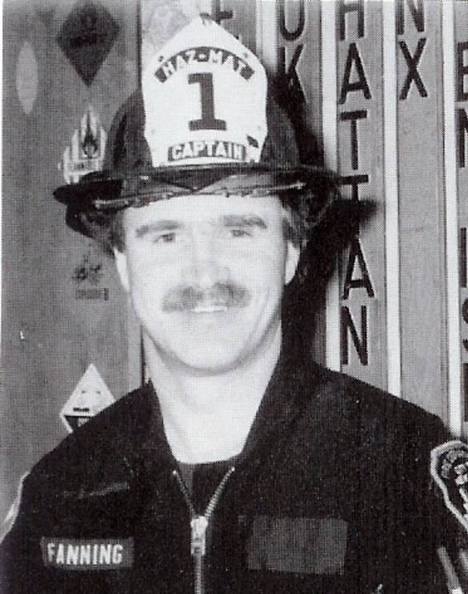
Joseph P. Gallagher
1st Captain
John J. Fanning
2nd Captain
1st Captain of Haz-Mat 1 prior experience in US Army wearing Chemical Protective Clothing for fueling missals. Promoted to BC and became Executive Officer of Rescue Services under Jim Duffy
2nd Captain of Haz-Mat 1 Worked in busy Fire Companies throughout his career before being promoted to BC. Chief in Charge of Technical Services. USAR NYTF-1 Task Force leader. Killed on 9/11.

Slide 3
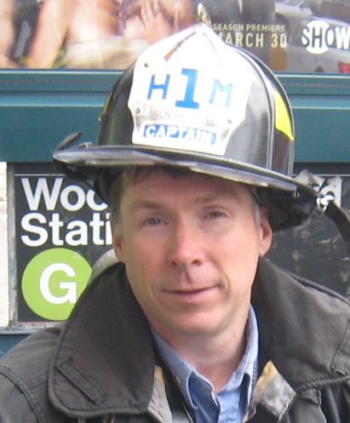
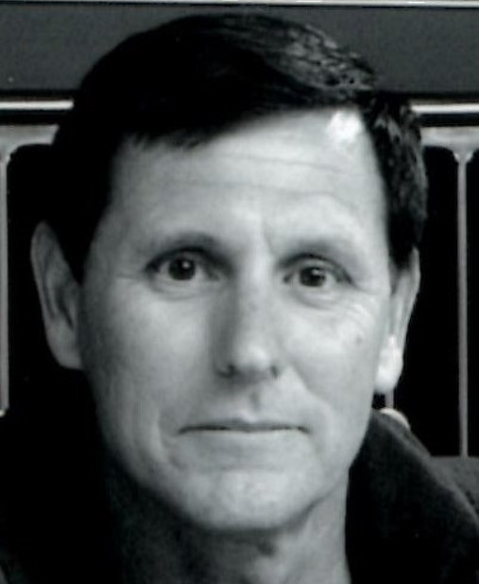
John Flynn
??? Captain
Steve Bacci
Unassigned Captain
Started as a covering officer before eventually becoming Captain of Haz-Mat 1. A Professional Engineer and a structural engineer with FEMA’s USAR NYTF-1.
Assigned as a Lieutenant to Haz-Mat-1. Newly promoted as a Captain he was assigned to the 3rd Division. On the night of 9/11 he came to Haz-Mat 1’s quarters, upon seeing the conditions, he called Division 3 and Spoke to Division Commander DC Casey; he told him he was staying. He Remained “OUR CAPTAIN” until April. He was there for us; when no one else was.

Slide 4
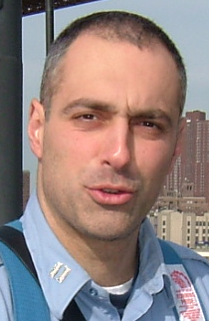
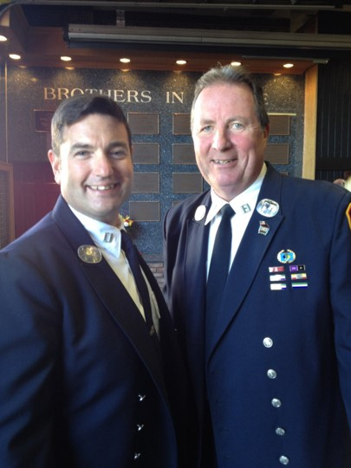
Nicholas Corrado
????? Captain
Vincent Doherty
???? Captain
Assigned as a firefighter, covered as a Lieutenant and eventually became Captain of Haz-Mat 1. Nick promoted up to Deputy Chief and as a Chief worked mainly in Manhattan. He has written numerous articles for WNYF publications
A charter member of the company who covered in the company as a lieutenant before becoming of Captain of Haz-Mat 1. He taught Chemistry at the National Fire Academy and a number of other educational institutions.

Slide 5
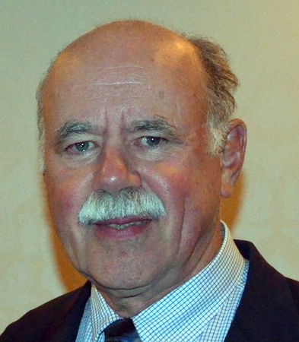
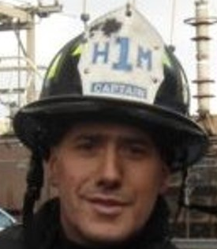
Keven Culley
??? Captain
James D’Avolio
??? Captain
A Charter Member, Company Officer and Captain of Haz-Mat 1 in April of 2002. An experienced Instructor of Chemistry at the National Fire Academy. Assigned to the Office of Emergency Management after his promotion to Captain
????????????????????????????????????????????????????????????????????????????????????????????????????????????????????????????????????????????????????????????????????????????????????

Slide 6
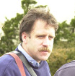
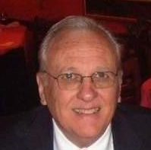
Brian Smith
??? Captain
Howard Kennedy
3rd Captain
????????????????????????????????????????????????????????????????????????????????????????????????????????????????????????????????????????????????????????????????????????????????????
3rd Captain of Haz-Mat 1. As a Lieutenant in L-154 was awarded the James Gordan Bennett and the Harry M. Archer Medals. Captain was assigned as the Captain of Ladder 4 prior to his assignment to Haz-Mat 1.

Slide 7
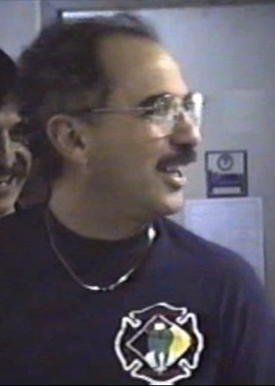
Patrick Waters
??? Captain
John Fatta
4th Captain
Covered as a Captain splitting the position with Tom Moody under the direction and evaluation of BC Fanning from 200 to September 11, 2001. Captain was killed at the World Trade Center on 9/11.
John Fatta was the 4th Captain assigned to Haz-Mat 1. Captain Fatta served most of his career as a Firefighter, Lieutenant, and Captain in the borough of Brooklyn prior to his assignment in Haz-Mat 1.

Slide 8
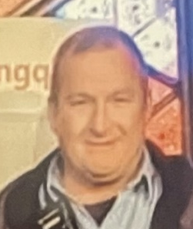
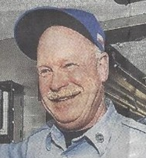
John Hansen
Current Captain
Paul Smith
???? Captain
Current Captain and longest Captain to date. ???????????????????????????????????????????????????????????????????????????????????????????????????????????????????????????????????????
???????????????????????????????????????????????????????????????????????????????????????????????????????????????????????????????????????

Slide 9
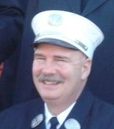
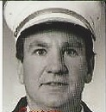
Tom Evans
??? Captain
Tom Moody
??? Captain
???????????????????????????????????????????????????????????????????????????????????????????????????????????????????????????????????????
Tom was assigned as a firefighter to Haz-Mat 1, worked there as a company officer before being promoted to Captain. As Captain he covered the Captain’s position with Pat Waters until his death on 9/11.

Slide 10
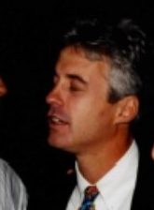
Pete Stuebe
??? Captain
Joseph Abbamonte
??? Captain
???????????????????????????????????????????????????????????????????????????????????????????????????????????????????????????????????????
???????????????????????????????????????????????????????????????????????????????????????????????????????????????????????????????????????

