Slide 1
Chief Officers in Haz-Mat History
This section is not just about the Chief Officers who eventually commanded Haz-Mat (Haz-Mat Operations & Special Operations Command) but about the members of Haz-Mat who eventually became Chief Officers and the highest ranks they attained in the FDNY

Slide 2
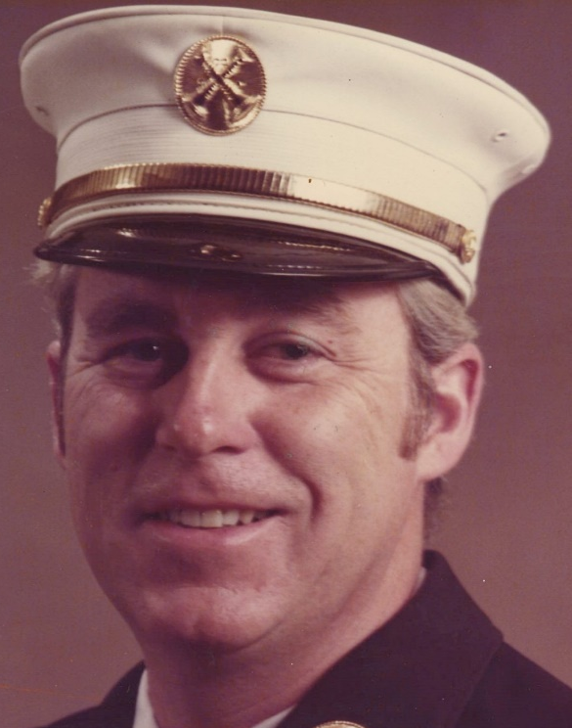
The Beginning (Rescue Services) Pre 1984
Ray Brown
  Formally the Captain of Rescue 1
  The 5 Rescues and Haz-Mat 1 under his command
  Retired and went on to become a manager for Emergency Services for the Port authority of New York and New Jersey

Slide 3
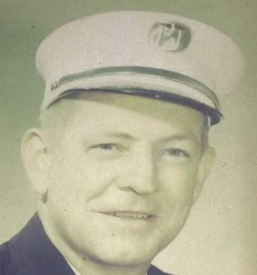
Deputy Chief
James Duffy
  The 5 Rescues and Haz-Mat 1 under his command
James Duffy Obituary
Published by Macken Mortuary - Island Park on Feb. 1, 2013.
Duffy, James J. Jr., US Naval Veteran, Devoted 39 years to FDNY. Retired Chief of Rescue Services. Decorated 9 times for valor and heroism. Beloved husband of Celine M. (nee: Dantzig). Devoted father of Mary Ellen Meehan (Jim) Byrne. Gary (Ann), James, Gerard (Jennifer), Bryan (Laura) and the late William. Adored grandfather of fourteen. Dear brother of Helen Healey. Reposing Macken Mortuary, Rockville Centre Chapel, 52 Clinton Avenue, today 2-4, 7-9 pm. Funeral Mass St. Agnes Cathedral Monday 1 pm. Interment Cemetery of the Holy Rood, Westbury, NY. In lieu of flowers donations may be made to NYC Fire Fighters Burn Center, 21 Asch Loop, Bronx, NY 10475, in his name would be appreciated. mackenmoruary.

Slide 4
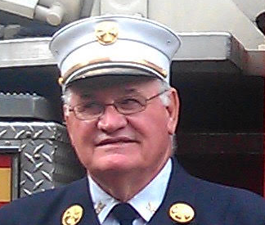
Deputy Chief
James T. Bullock
Chief in Charge FDNY Rescue Services
Prior to retiring in 1999 Jim dedicated 30 years to keeping NYC safe as an integral member of the FDNY. He was promoted to the Chiefs rank in less than 18 years of service. Jim spent almost his entire FNDY career in Manhattan with diverse building structures that range from high-rise commercial and residential buildings to hotels and hospitals, from theaters, places of worship, and courthouses to many commercial and landmark buildings. While on active duty, Jim was the Commanding Officer of the Special Operations.
While at Special Operations, Jim reorganized the elite units of the Command. He supervised all fire department units, other than Engine and Ladder companies, Rescue Companies, Rescue Tactical Units, HazMat Operations, Marine Units, Decontamination Units and Dewatering Units.
Jim also coordinated the merger of the Emergency Medical Service’s Special Operation Division into the Fire Department’s Special Operation, initiated and developed Technical Rescue School and Hazardous Material Training School, originated the placement of fast response boats (Auxiliary Rescue Craft), developed the Rest and Recuperation Units assigned to all Boroughs of city, and tested the performance of bunker gear with sarin never gas simulate with the US Army at the Aberdeen Proving Grounds.

Slide 5
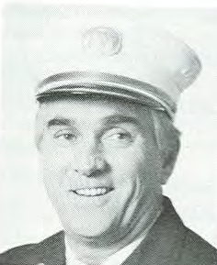
Covering Officer to Acting Deputy Chief
Raymond M. Downey
  Formally the Captain of Rescue 2
  Founding Member FEMA USAR NYTF-1
  Commanded Rescue Operations
  Became Chief of Special operations Command SOC
  Killed on 9/11

Slide 6
Captain to Acting Deputy Chief
Joseph P. Gallagher
  1st Captain of Haz-Mat 1
  Executive Officer of Rescue Services under James Duffy
  Joe Gallagher, became the Commanding Officer of SOC when Jim Duffy retired.
  Ray Downey was his replacement after the 1993 WTC bombing. His Executive Officer was BC Jack Kelly. Jack Kelly had no other interaction with Haz Mat or SOC that I am aware of before or after XO position. Malcolm Moore is the current SOC Commander.

Slide 7
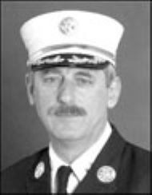
Charter Member to Deputy Assistant Chief
John Norman III
  Charter Member of Haz-Mat 1
  As Battalion Chief assigned to Rescue Operations
  Commanded Special Operations Command
  Authored Several Fire Service books and publications (see the Books section of this WEBSITE)
  Instructor and Lecturer at seminars throughout the US, Canada, and Europe
  Taught USAR Rescue Specialist Training Programs
  FDNY Foam Coordinator’s Class, First Line Supervisors Program and Chief Officer Development Classes at the “ROCK”
  Posts a daily fire blog at @Chiefnormanfdny on Instagram
  West Point’s Response to Terrorism Program

Slide 8
Assistant Chief
Frank J. Nastro jr.
Commanded Rescue, Haz-Mat and the Marine Division in the early years
Went on to become Assistant Chief of operations

Slide 9
Covering Officer to Assistant Chief
Thomas J. Haring
  Covering Officer
  1st Chief to Command Haz-Mat Operations
  Instrumental in getting the Haz-Mat Command started
  1st headquartered with the Marine Division at the Brooklyn Navy Yard
  Became Deputy Bronx Borough Commander
  Became Staten Island Borough Commander

Slide 10
Charter Member to Battalion Chief
Robert Ingram
Charter Member of Haz-Mat 1
Covered as Administrative/Line Company Officer as a Lieutenant.
Covered as a Captain for relief assignments.
1st Commanding Officer HMT School.
Executive Officer HM Operations under Chief Fanning.
Executive Officer Special Operations Command under AC Cruthers until 9/11.
Commanded Haz-Mat Operations after
Chief Fanning was killed on 9/11 9/12/01 until 09/01/07
FDNY WMD Chief CTDP 09/01/07-12/2017

Slide 11
Battalion Chief to Deputy Assistant Chief
William Siegel
  Commanded the Marine Division
  Chief in Charge Special operations Command

Slide 12
Deputy Chief to Assistant Chief
William Seelig
  Commanded Rescue Operations
  Chief in Charge Special operations Command

Slide 13
Assistant Chief
Michael C. Weinlein
  Chief in Charge of Special operations Command

Slide 14
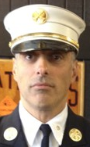
Firefighter to Deputy Chief
Nicholas Corrado
  Firefighter in Haz-Mat 1
  Covered as company officer
  Captain of Haz-Mat 1
  Author WNYF articles

Slide 15
Deputy Chief to Assistant Chief
Donald Devine
  Chief in Charge Special operations Command

Slide 16
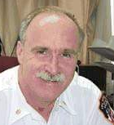
Captain to Battalion Chief of Haz-Mat Operations
John J. Fanning
  2nd Captain of Haz-Mat 1
  Chief in Charge Technical Services
  Founding Member FEMA USAR NYTF-1
  Chief of Haz-Mat Operations
  Killed on 9/11

Slide 17
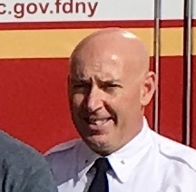
Haz- Mat Operations Chief
Nicholas Del Ray
  Haz-Mat Battalion Chief
  Haz-Mat Battalion Commander
  Haz-Mat Division Commander
  Chief in Charge Haz-Mat Operations

Slide 18
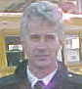
Covering Officer to Captain of Haz-Mat 1 to Battalion Chief
Peter Stuebe
  Covering Officer in Haz-Mat 1
  Captain of Haz-Mat 1
  Worked in Haz-Mat Battalion

Slide 19
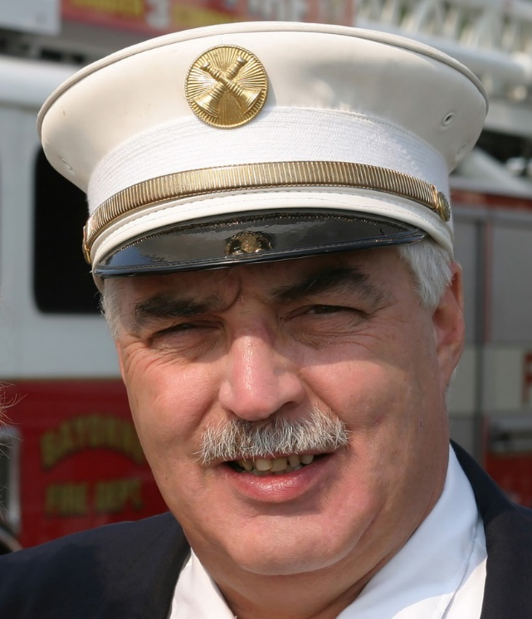
Company Officer to Battalion Chief
Jack Calderone
  Charter Member in Haz-Mat 1
  Original Company Officer
  Went on to promotion as Battalion Chief
  Authored many WNYF Articles
  Editor in Chief Fire Apparatus Journal

Slide 20
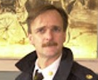
Haz- Mat Battalion Chiefs
Chief Schueck
  Worked in Haz-Mat Battalion

Slide 21
Haz- Mat Battalion Chiefs
Missing Battalion chiefs
  Rich Schlueck
  Ed Bergamini
  Robert Strakosch
  Michael O’Kelly
  Frank Naglieri
  Timothy Rice
  Mark Becker
  4 current BC’s
  DC Daniel Murray
Need
picture

Slide 22
Haz- Mat Battalion Chiefs
Missing battalion chiefs
  Firefighter in Haz-Mat 1
Need
picture

Slide 23
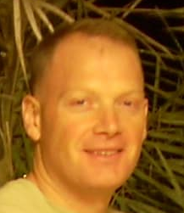
Firefighter to Battalion Chief
Steve Fitzgerald
  Firefighter in Haz-Mat 1
  Covered as Company Officer
  Worked in Haz-Mat Battalion

Slide 24
Firefighter to Battalion Chief
Steve Fitzgerald
  Firefighter in Haz-Mat 1
  Covered as Company Officer
  Worked in Haz-Mat Battalion
Need
picture

