Slide 1
Company Officers in Haz-Mat 1 History
This section is just about the Company Officers who worked as Lieutenants or Captains in Haz-Mat 1. Some started as firefighters in the company and rose to other ranks if they are not found in the Chiefs and Captains of Haz-Mat 1 sections they probably reside here.

Slide 2
Joseph T. Buell
Lieutenant
John A. Crisci
Lieutenant
James G. Oliveri
Lieutenant

Slide 3
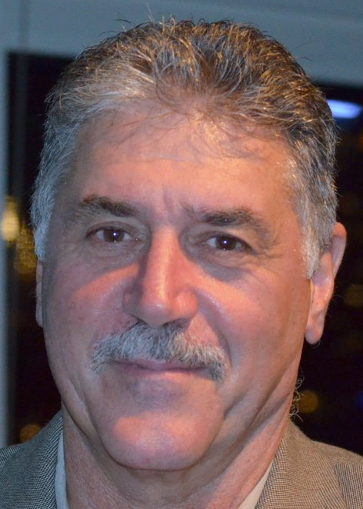
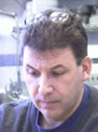
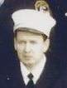
Danny Pontecorvo
Lieutenant
Tony Mussorfitti
Lieutenant
Ed Connelly
Lieutenant

Slide 4
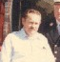
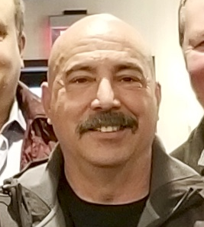
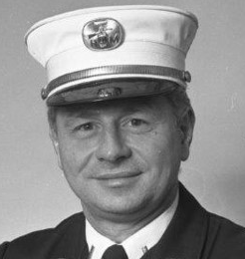
Al Jardin
Lieutenant
Stan Rybak
Lieutenant
Al Warta
Lieutenant

Slide 5
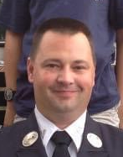
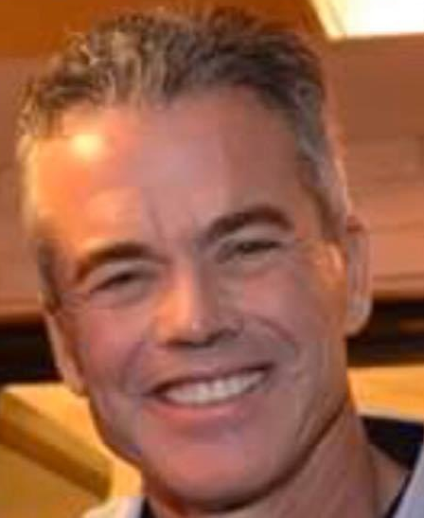
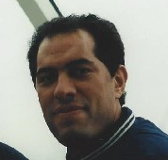
Bob Crowe
Lieutenant
John Cassidy
Lieutenant
Paul Rogers
Lieutenant

Slide 6
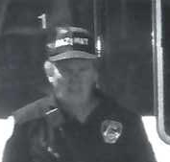
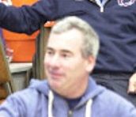
Joseph Nallan
Lieutenant
Mike Mulqueen
Lieutenant
Neil Scow
Lieutenant
Missing
Picture

Slide 7
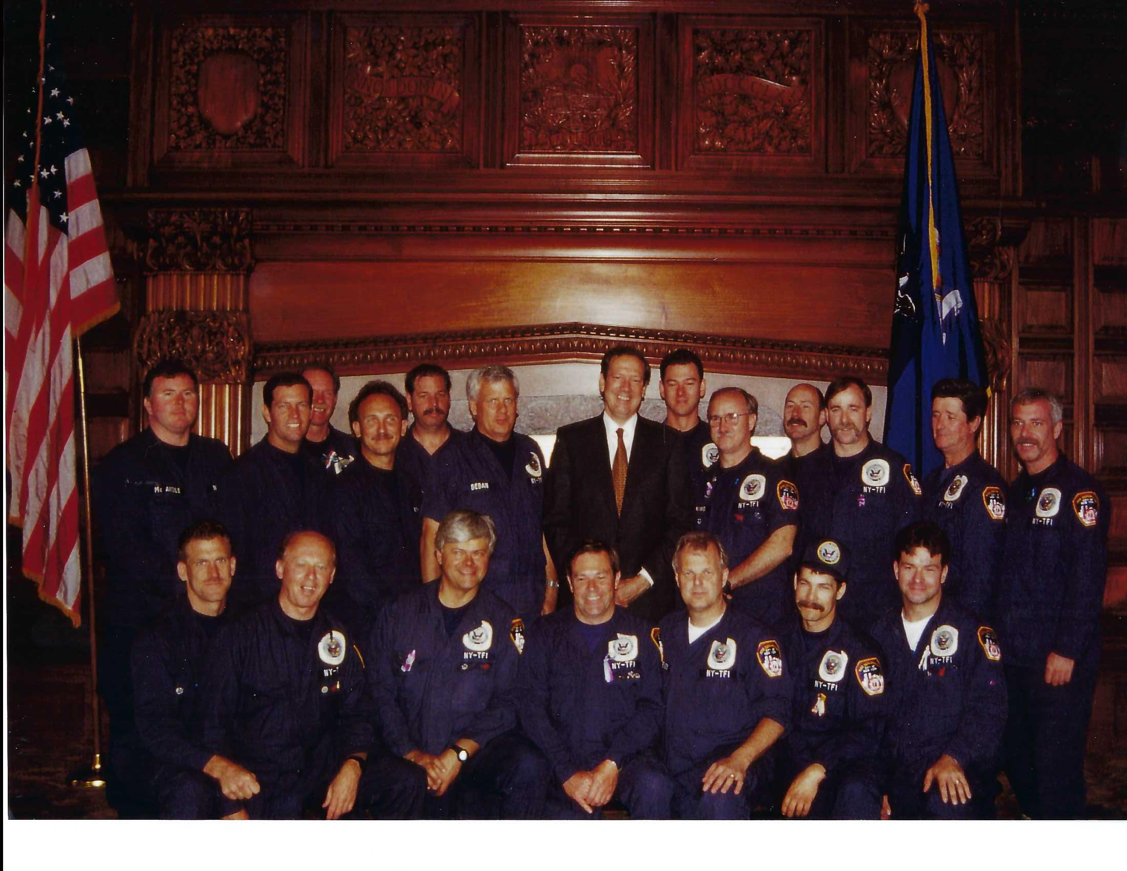
Kevin Dowdell
Lieutenant (cov)
Steve Spall
Captain (cov)
John Ferry
Captain (cov)

Slide 8
Terry Hattan
Captain (cov)
Craig Shelly
Battalion Chief (cov)
Jim Ellison
Captain (cov)

Slide 9
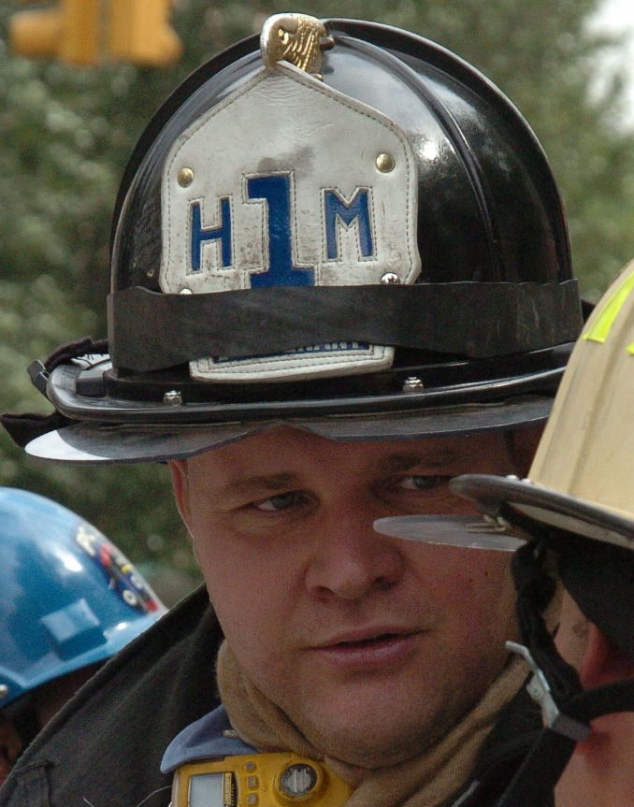
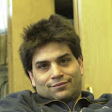
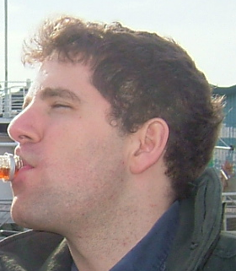
George Hough
Lieutenant
Anthony Castagna
Lieutenant
Antinio Benetatos
Lieutenant

Slide 10
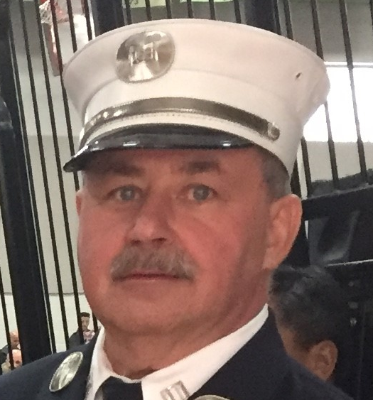
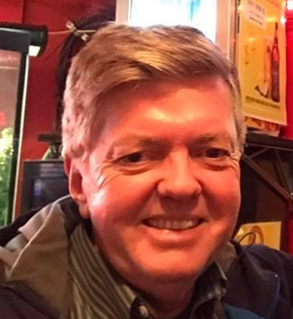
James Hay
Captain
Pete Gorman
Captain
???????????????????????????????

